Slide 1
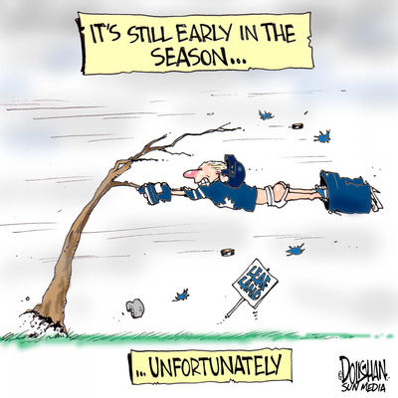
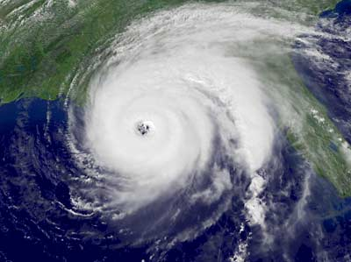
Hurricanes
Aims: To be able to describe where Hurricanes form and understand why they form in these locations.

Slide 2
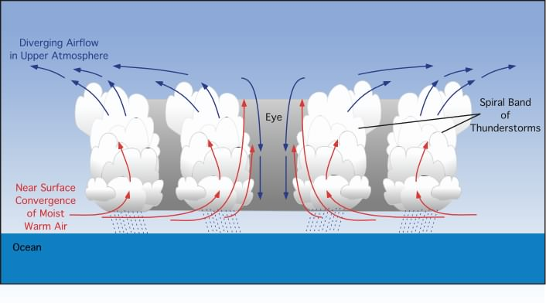
Why do Hurricanes form here?
Fill in the story board whilst watching the Hurricane animation.
Click link above for animation

Slide 3
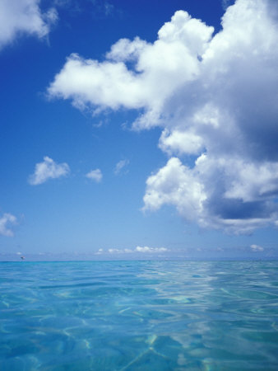
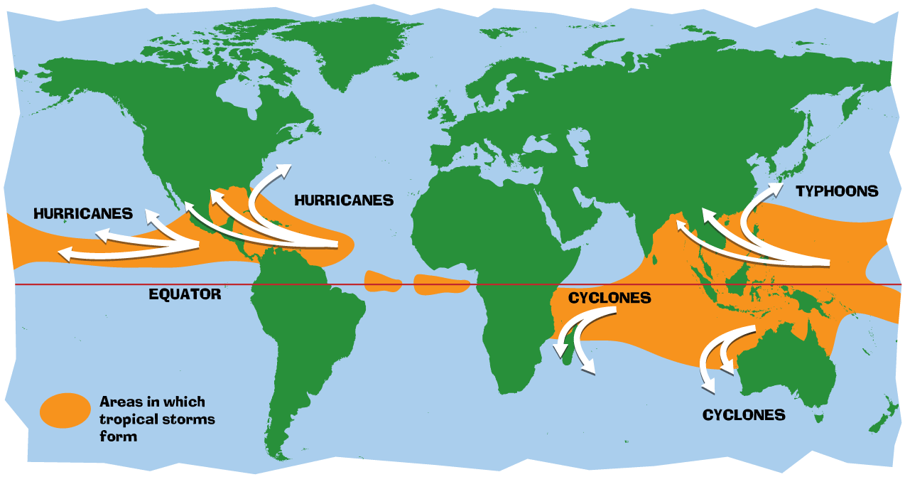
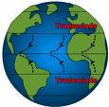
Exam questions
Describe the location of where tropical storms form (3 marks).
Explain why Tropical Storms occur in these parts of the world (3 marks).

Slide 4
Describe the location of where tropical storms form (3 marks).
Mark scheme
3 locational points needed. These could include:
They form between the equator and tropic of Cancer/Capricorn (1).
The firm to the north and south of the equator (1)
Could mention a specific ocean for (1)
Could say to the east of Asia/North of Australia for (1)

Slide 5
Explain why Tropical Storms occur in these parts of the world (3 marks).
MARK SCHEME
Oceans have deep seas which are needed for formation (1)
Around the equator are warm seas (above 27 degrees) which are needed for formation (1) as air will rise to form a low pressure system (1) rising moist air then condenses forming the thick clouds and heavy rain (1)
At the equator, the trade winds help the storm to spin (1).

