Slide 1
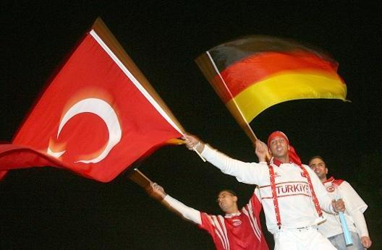
Migration of Turks to Germany
(Voluntary Economic Migration)

Slide 2
West Germany needed rebuilding after World War 2 in 1945
Extra labour was needed
Workers moved from poorer European countries like Turkey to Germany
Many of the first Turkish migrants were from farming coummunities so they went to agricultural jobs in West Germany
Then they got slightly better paid jobs in factories and construction

Slide 3
Many of the jobs were dirty, unskilled, low paid and ivolved working long unsociable hours. Many Germans did not want to do these jobs
By 1989 German had 4.5 million ‘guest workers’ which was 7.4% of the working population.
Nearly one third of these were from Turkey
Most of the Turks that arrived were male and aged 20-29 (see pyramid page 28 in text book)
After 1973 recruitment of foregn workers became illegal
However, many Turks still arrive to be united with their families
Turks have their own centres in many German centres – they speak their own language and have their own culture (food, dress and entertainment)

Slide 5
Problems since 1989
The collapse of the wall in 1989 meant that many eastern Europeans arrived in Germany seeking jobs
Many of these wanted the type of jobs that were done by the Turks in Germany
By the mid 1990s 30% of Turks were unemployed in Germany
Increased racism has been a huge problem

Slide 6
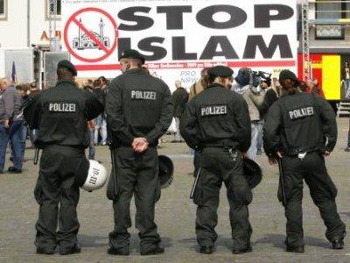

Slide 7
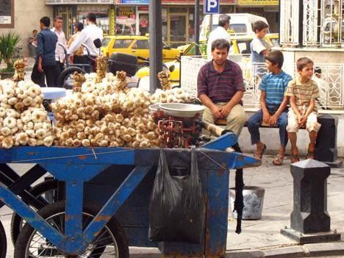
Advantages for the losing/origin country (Turkey)
Reduced pressure on jobs and resources eg food
Loses people of child bearing age and so these is a decreased birth rate
Migrants develop new skills which they may take back to Turkey
Money earned in Germany is sent back to Turkey (remittances)

Slide 8
Disadvantages for losing/origin country (Turkey)
Loses people in working age group
Loses people most likely to have some skills and education
Mainly males leave and families are divided
Elderly people are left behind which increases death rate

Slide 9
Advantages for receiving/host country (Germany)
Overcomes labour shortage
Workers prepared to do the jobs that locals do not want to do
Work for long hours for little money
Cultural advantages (eg restaurants)
Some highly skilled workers

Slide 10
Disadvantages for receiving/host country (Germany)
Puts pressure on jobs
Low quality overcrowded houses
Ethnic groups do not tend to integrate
Racial tension
Limited skilled workers arriving
Language problems
Sometimes health problems

