Slide 1
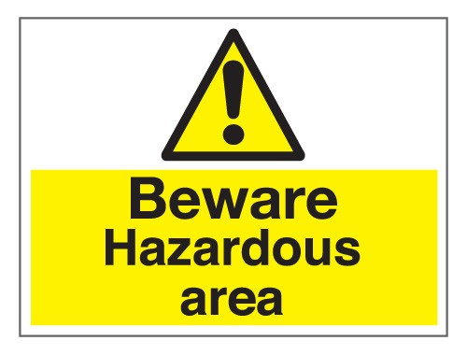

Slide 2
Why do people live near Hazards?
Fatalistic Approach
Acceptance Approach
Adaptation Approach

Slide 3
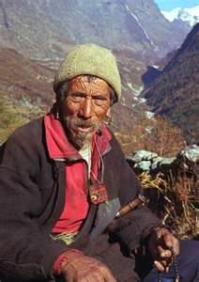
If it happens, it happens, and it’s all part of living in this area.
FATALISTIC APPROACH

Slide 4
“Russian Roulette”- an optimistic approach.
Some communities would go as far as to say hazards are “God’s will”.
Populations take direct action that is concerned with safety.
Losses are accepted as inevitable.
People remain where they are.
Lack of alternatives- often economically orientated.
FATALISTIC APPROACH

Slide 5
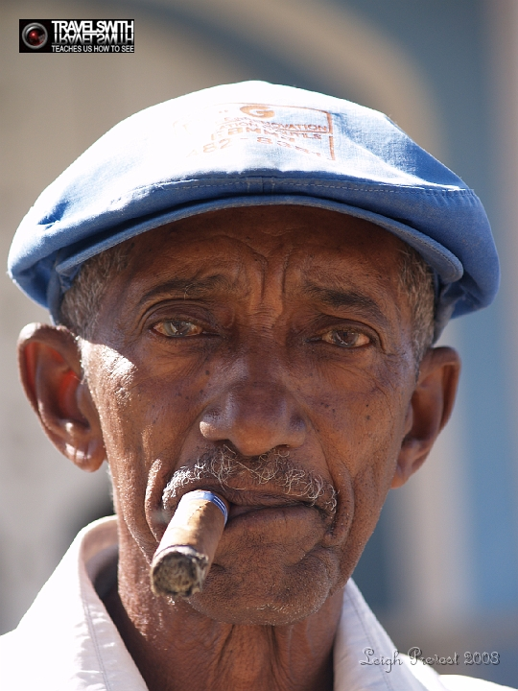
Hazards are a part of everyday life that we try and live with. We know hazards happen but we continue to live in this area because it has many advantages.
ACCEPTANCE APPROACH

Slide 6
Accept the risks that hazards present because the advantages are greater.
Costs versus benefits.
Tourism.
Energy generation.
Opportunity for intensive agriculture.
Mining and mineral extraction.
ACCEPTANCE APPROACH
California- is it worth the risk??

Slide 7
Events can be prevented and warnings given. The area has been made safer using modern technology, so even if a disaster occurs, few people will be affected.
ADAPTATION APPROACH

Slide 8
People see that they can prepare for, and therefore survive, the hazard.
Prediction.
Prevention.
Protection.
ADAPTATION APPROACH

Slide 9
Overview of reasons
Poverty: In many countries people are simply to poor, not to live in hazardous areas. This is especially true for newly arrived migrants who may be forced to build on marginal land e.g. a steep hill that is vulnerable to landslides or a river or coastline that is vulnerable to flooding. Fertile soil: The minerals released during volcanic eruptions make the soil extremely fertile and ideal for agriculture. In countries like Indonesia, Philippines and El Salvador you will find people farming up very steep volcanic slopes, often building terraces to make farming easier. Geothermal Energy: Where there is volcanic activity, it is normally possible to source the renewable energy of geothermal power (basically using the heat of the land to generate electricity). El Salvador has a geothermal power plant and countries like Iceland use geothermal power to generate electricity and heat water. Tourism: Volcanoes Aoften become very popular tourists attractions. People like to look at them, climb them and hopefully view stunning volcanic lakes or possibly lava. In Central America there are a whole series of volcanoes that have become popular tourist attractions ranging from Pacaya and Agua in Guatemala, to Santa Ana and El Boqueron in El Salvador, Masaya in Nicaragua and Arenal in Costa Rica. Mount Fuji (a volcano) National Park in Japan is the most visited national park in the world. Also volcanic areas often have natural thermal springs, Japan is famous for its onsen and Iceland is famous for its Blue Lagoon.

Slide 10
Resources: Some minerals like sulphur are located on the slopes of volcanoes. But also other minerals like the huge deposits of copper in the Atacama Desert, Chile are located near tectonically active areas and attract large numbers of people.
Beauty: Volcanoes can be extremely beautiful to look at. Mount Fuji is a perfect volcano and stunning to look at so many people chose to live near it. When Mount St. Helen's volcano erupted some of the victims were people that refused to leave their houses because they loved the area so much. Friends and family (inertia): Some families have lived in hazardous locations for generations. Their family homes and business are located in the area and people simply don't want to leave or possibly can't afford to leave. Employment: Some hazardous areas offer good employment opportunities. For example many of the best tourist and fishing locations are found in coastal areas in the tropics e.g. the Caribbean, the Philippines and the Maldives. All three of these places are extremely vulnerable to hurricanes and flooding. Ignorance: Some people are simply unaware that they are living in a hazardous area. If an earthquake or hurricane has not hit somewhere in recent history or a volcano has not erupted for many hundreds of years, then people forget or are unaware that they live near a potentially dangerous hazard.

Slide 11
Preparation: Most countries now prepare their citizens much better for hazards. People are educated about how to protect their home, how to evacuate, etc. This preparation gives people the reassurance to live in hazardous areas. Hazard Recurrence: If some hazards don't occur very often, or certainly hazards of high magnitude don't happen very often then people will be prepared to take the risk. For example, on average only one supervolcano erupts every 10,000 years, so people are going to be happy to live near one, because the chances of it erupting during their lifetime is very low. Building Design: Because of improved building design people now feel more confident of living in hazardous areas. Buildings are now designed to withstand earthquakes, hurricanes, etc. Most countries also have pretty strict regulations when building new structures. Defences: Many countries and regions have built defences to protect from hazards e.g. levees on rivers and sea walls along the coast. These defences give people greater confidence to live and work in known hazard zones. Hazard Mapping: Many countries now map their countries in terms of potential risk and exposure to hazards. Because people have been told to live in relatively safer (not totally safe) areas they are more confident about living near hazards.
Prediction: More and more people are prepared to live in hazardous ares because they trust scientific prediction. They believe scientists will be able to predict flood events, volcanoes and hurricane and give them adequate warning to protect themselves and their property.

Slide 12
Tasks
Mt Pinatubo article. Why is this an example of a fatalistic approach? Were there any groups that didn’t share this approach?
California article. List detailed reasons why people live there ( the benefits).
Istanbul article. Explain how this project fits the adaptation approach.

Slide 13
Application
For each of your hazard case studies describe whether they show elements of fatalism, acceptance or adaption (or a combination of the three) approaches.

