Slide 1
What a Relief!

Slide 2
Learning Objective
To understand how height is shown on a map.
Success Criteria
To consider the different methods used to show height on a map.
To interpret contour lines to show the height of the land.
To interpret contour patterns to show the shape of the land.

Slide 3
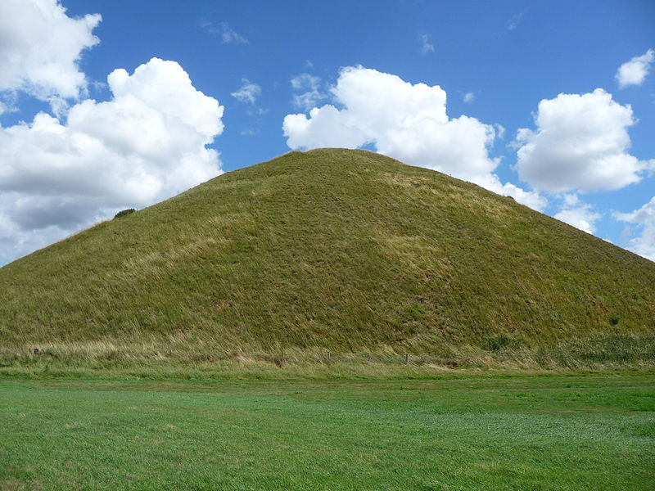
Think, Pair, Share
It is easy to see from the photograph that this is a hill...
Keywords
Relief – the difference between the highest and lowest heights of an area.
Topography – the surface features of the earth like hills, mountains, valleys etc..
... but how could this hill be shown on a map?

Slide 4
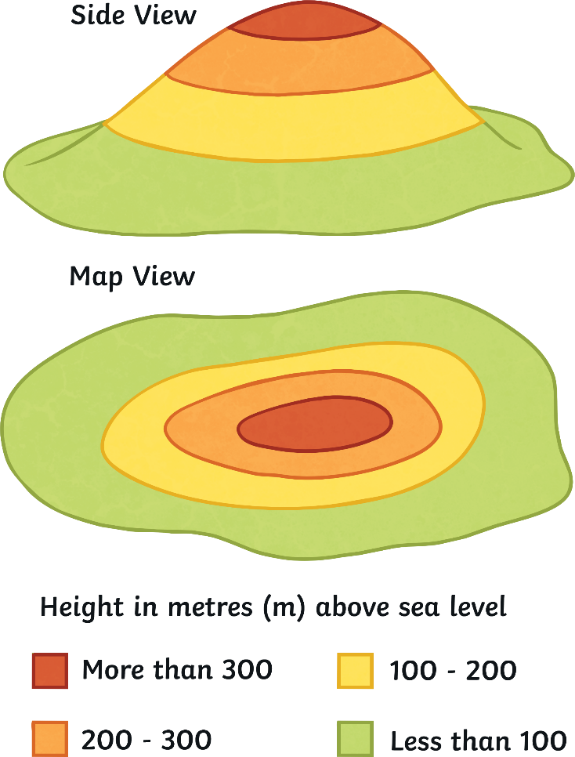
How Is Height Shown on a Map?
There are three ways of showing height on a map:
1. Layer Shading
Areas of different heights are shown using different colours. A key is used to show how high the land is.
Heights are usually shown in metres above sea level.
What is the height of the land at A, B and C?
A
B
C
A = less than 100m
B = 200-300m
C = more than 300m

Slide 5
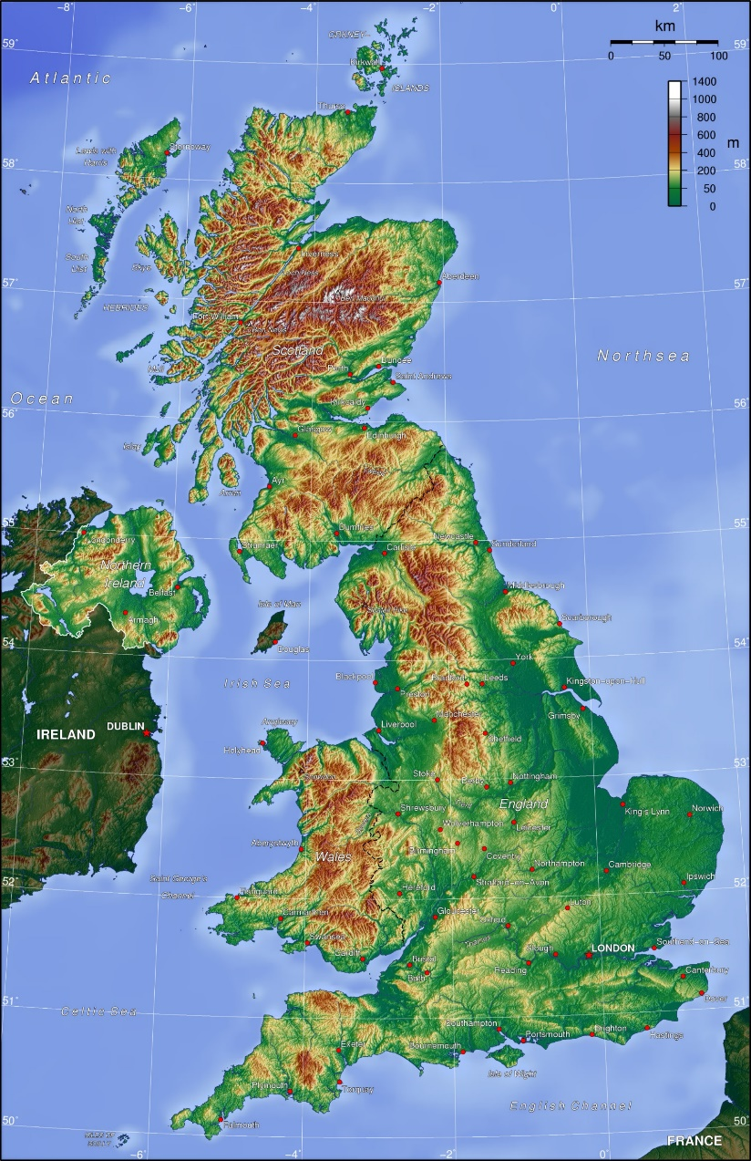
Layer Shading
Layer shading is often used on maps of very large areas like countries. It gives a good overview of the relief of that area.
The highest areas are usually shaded in brown and the flatter areas in shades of green.
How would you describe the relief of the UK?

Slide 6
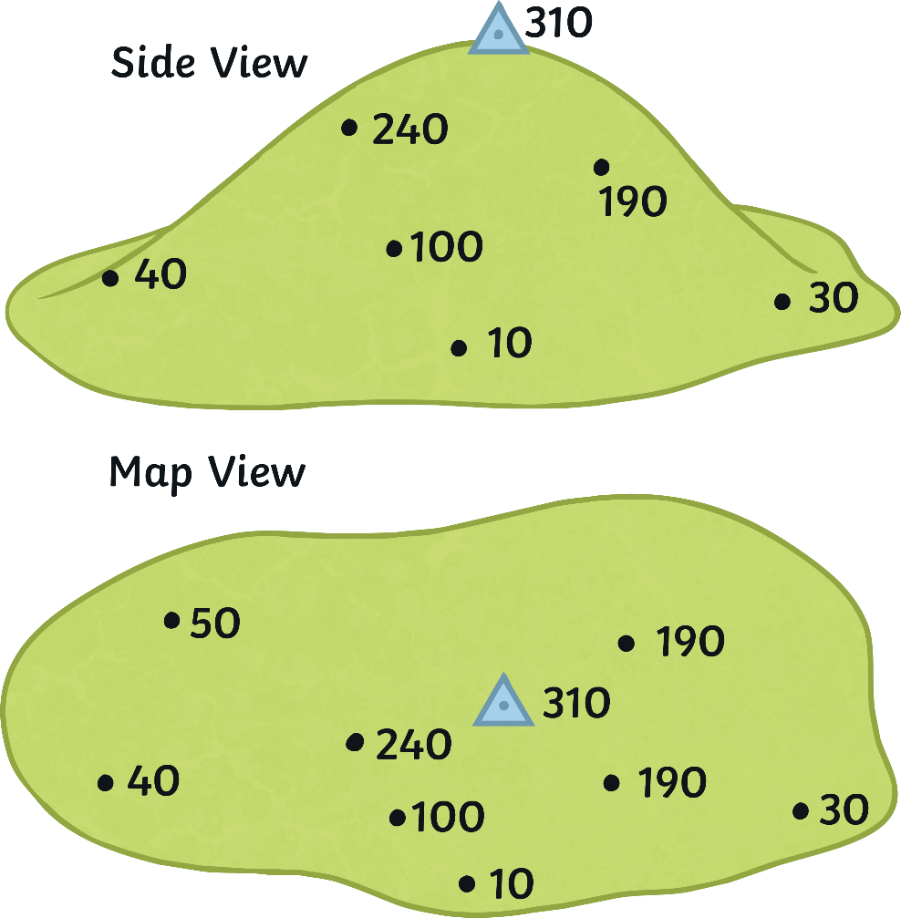
How Is Height Shown on a Map?
2. Spot Heights
The exact height of a place above the ground is measured and written onto a map.
What does the blue triangle on the map represent?

Slide 7
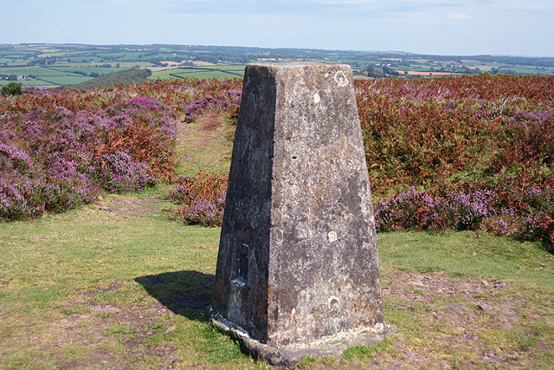
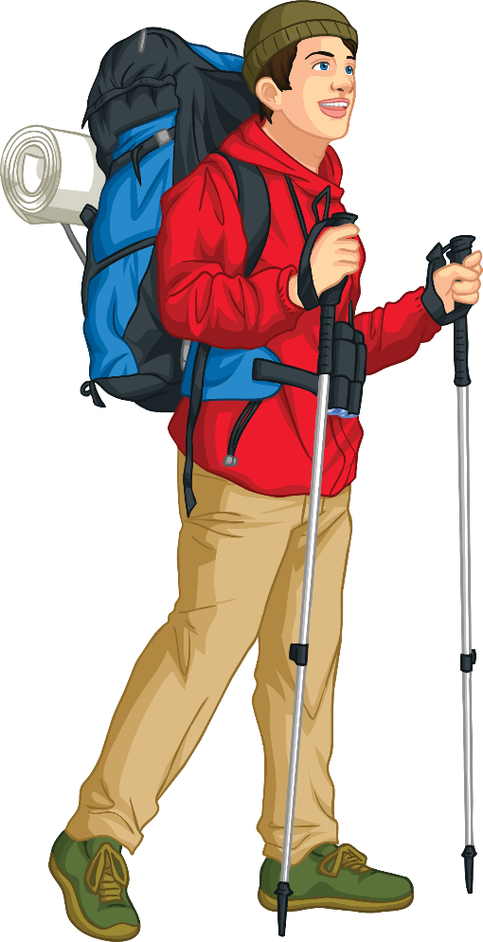
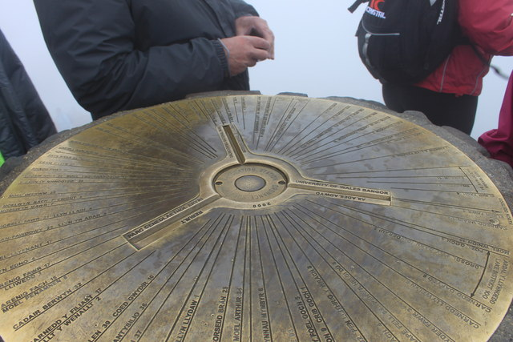
How Is Height Shown on a Map?
The blue triangle represents a triangulation pillar or trig point. These concrete pillars were built in the 1930s to help make accurate maps. Over 6,500 were built and many remain today.
Some triangulation pillars have compass bearings on the top showing the direction and distance to different places.

Slide 8
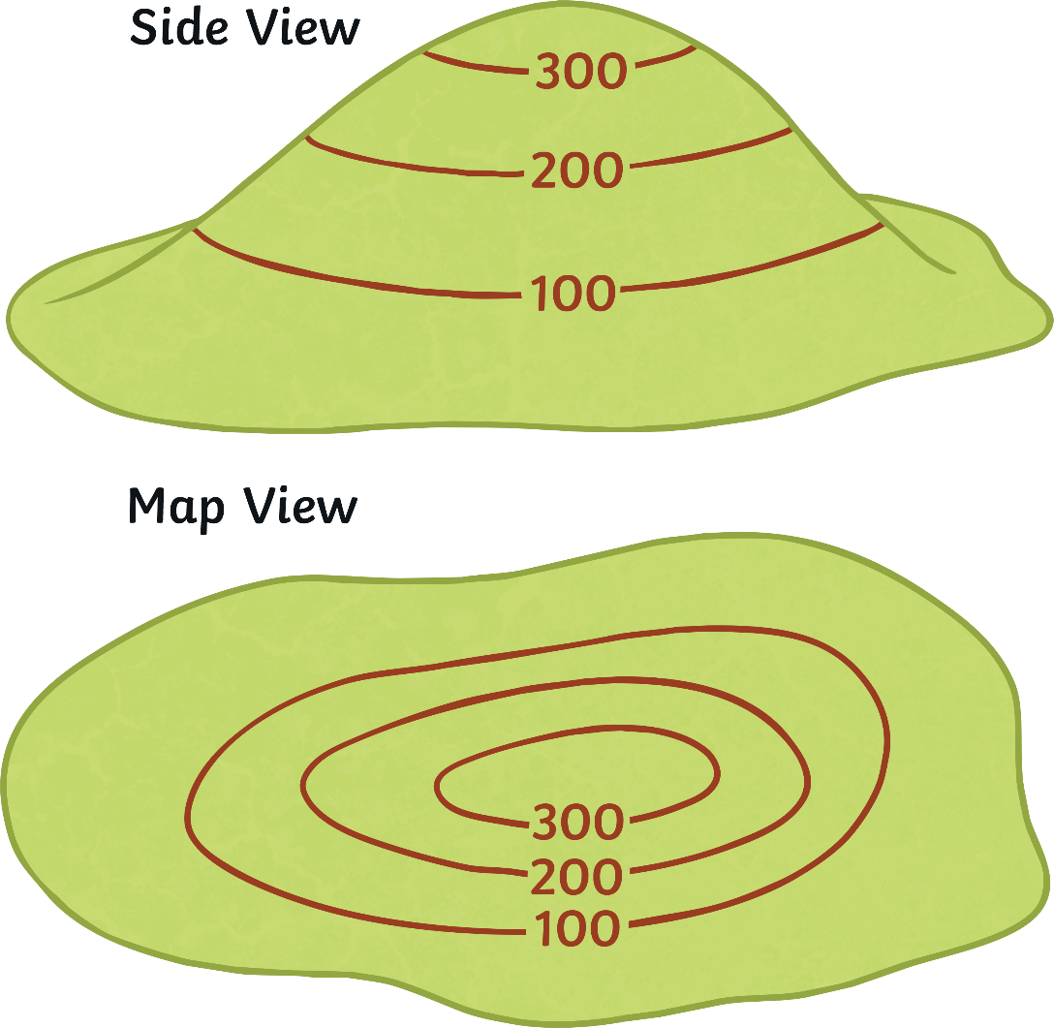
How Is Height Shown on a Map?
3. Contour Lines
Contour lines are lines on a map which join up places of the same height. Everywhere along a contour line is the same height. Contour lines are usually coloured brown/orange on a map.
The contour interval is the difference in height between contour lines.
The contour interval on this map is 100 metres.
Everywhere along this contour line is 100m above sea level.

Slide 9
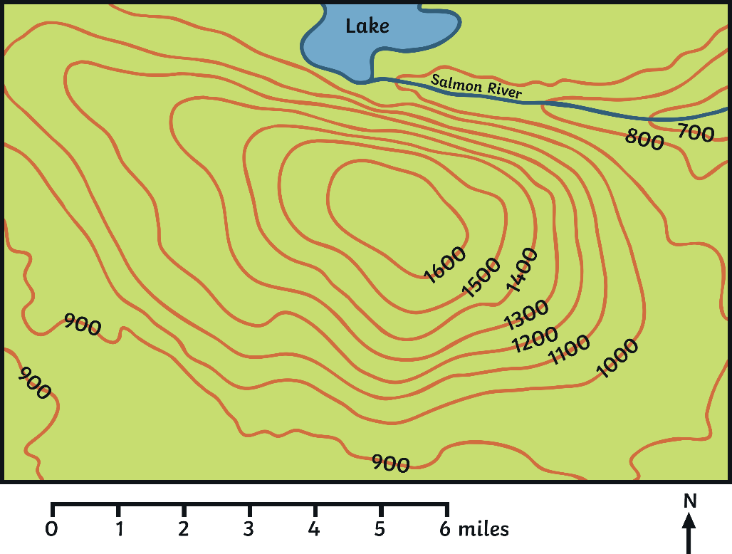
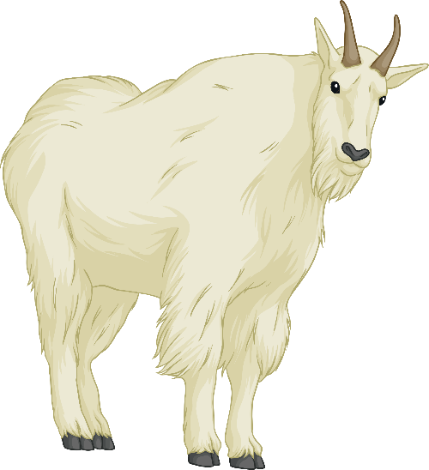
How Is Height Shown on a Map?
Contour lines show the height of a place.
What is the height of the land at:
A?
B?
C?
D?
C
B
900m
1300m
1600m
950m
D
A
Location D is halfway between two contour lines so we estimate the height.

Slide 10
How Is Height Shown on a Map?
Contour lines can also show the shape of the land.
A V-shaped contour pattern which decreases in height shows a valley. A river is a good clue that there is a valley.
valley
flatter land
hill
Circular contour lines which increase in height show a hill.
steeper land
Contour lines which are far apart show that the land is flatter.
Contour lines which are close together show that the land is steep.

Slide 11
Stop and Admire the View
What Can You Remember?
Height of the Land
Identify the three ways that height can be shown on maps:
a. ………………..
b. …………………
c. ………………….
Steep or Flat?
a. Contour lines which are close together show that the land is ……….
b. Contour lines which are far apart show that the land is …………
Contour Patterns
Contour pattern A shows a ………….
Contour pattern B shows a ………….
300
A
200
100
B
300
200
Extension
Think of three reasons why contour lines are useful.
100

Slide 12
Stop and Admire the View
Answers
Height of the Land
Identify the three ways that height can be shown on maps:
Steep or Flat?
a. Contour lines which are close together show that the land is b. Contour lines which are far apart show that the land is
Contour Patterns
Contour pattern A shows a
Contour pattern B shows a
a. layer shading
b. spot heights
c. contour lines
steep.
flat.
hill.
300
A
200
valley.
B
100
300
200
100

Slide 13
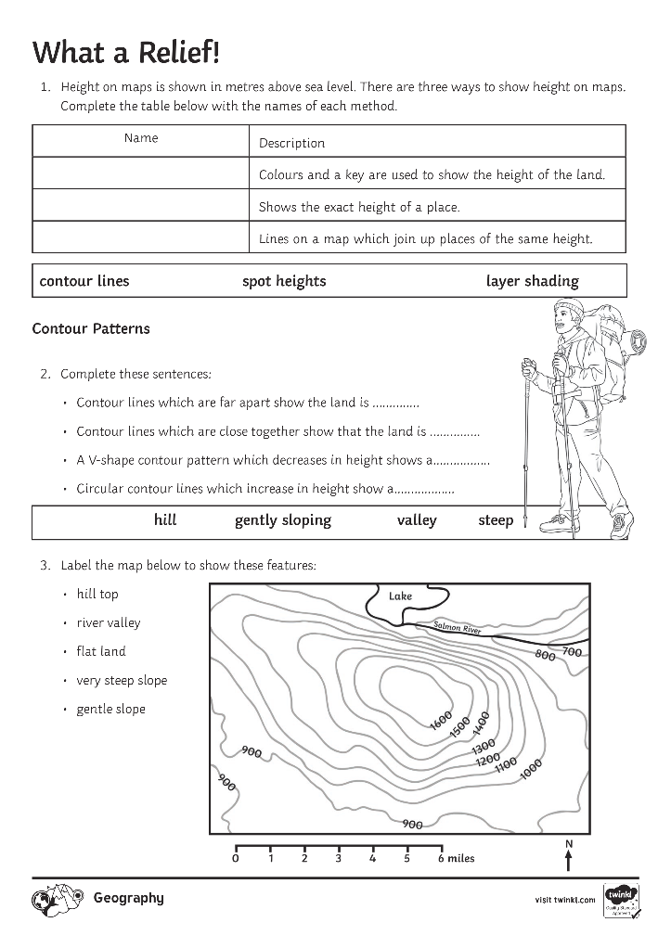
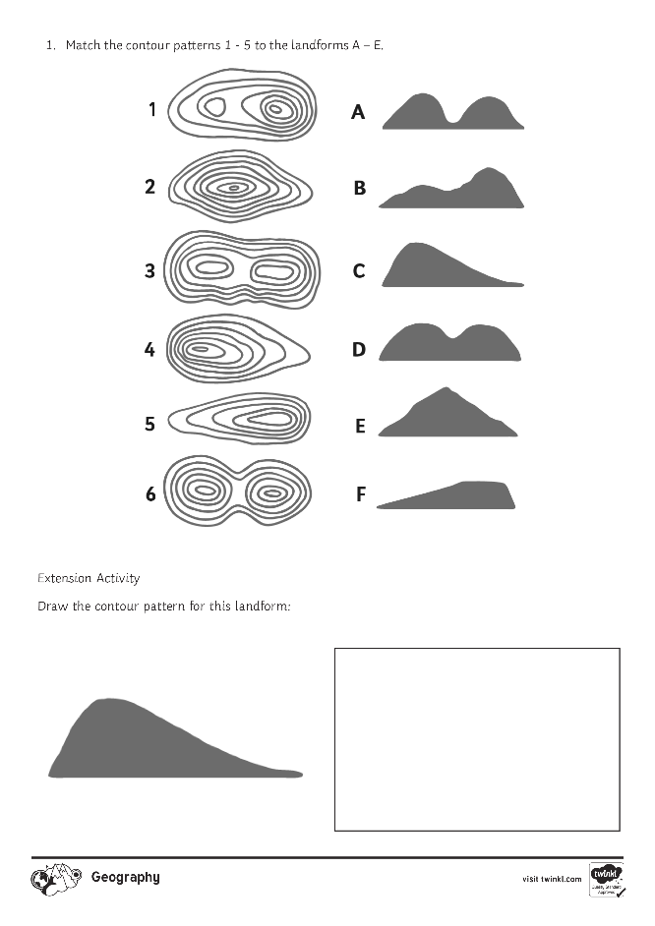
How is Height Shown on a Map?
Complete the What a Relief! Activity Sheet.

Slide 14
Maptastic!
You have 1 minute to tell your partner the key learning points from this lesson about how height can be shown on maps!

