Slide 1
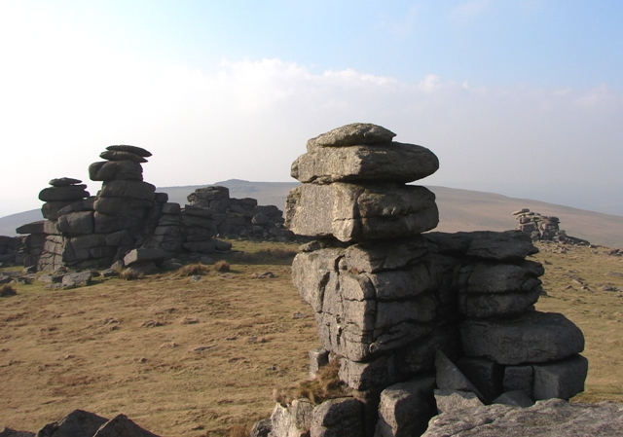
What questions could you ask about this photograph?
Who?
Where?
When?
How?
What?
Why?

Slide 2
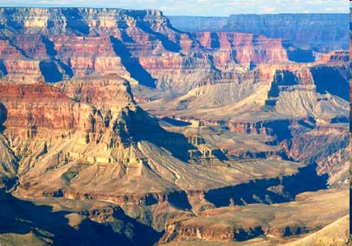
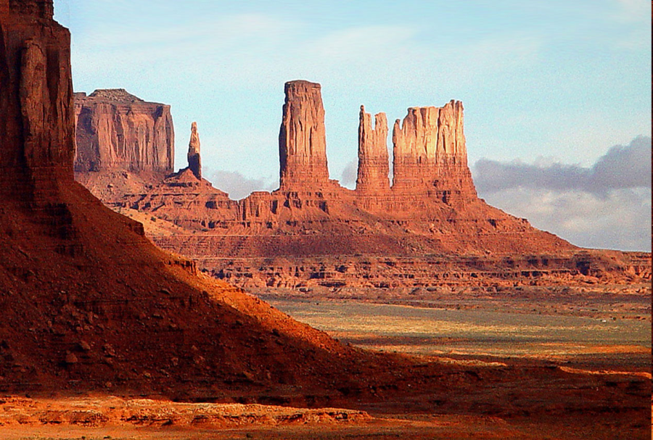
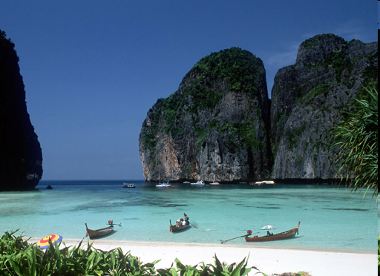
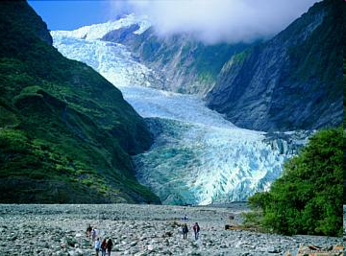
There is a great variety of scenery in the world. Geographers call the scenery of a place the landscape. The features and soils that make up a landscape depend on the type of rock and the type of weathering.

Slide 3
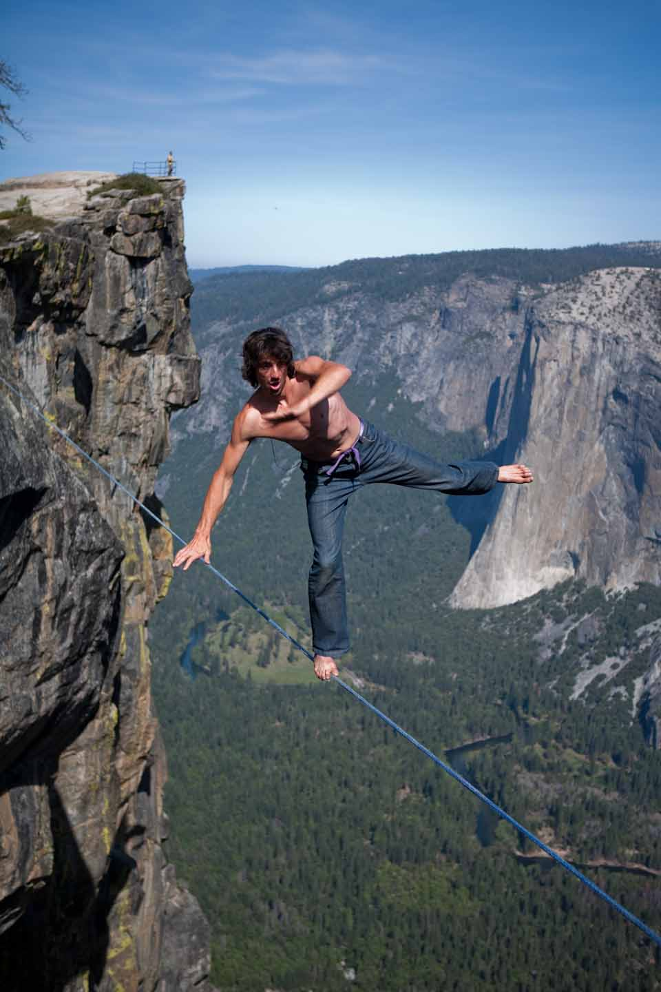
Landscapes: Granite
Learning objectives:
To know the basic characteristics of granite
To understand the landscapes it forms
Notes:
https://www.youtube.com/watch?v=leCAy1v1fnI – FREE CLIMBING IN YOSEMITE

Slide 4
Landscapes: Granite
Task:
What is granite like?
Watch the following video clip (7mins) about the granite in Yosemite National Park, USA and try to list everything you hear about Granite
http://www.youtube.com/watch?v=Y5RQp77uVPA
Amazing rock climbers (who use granite!)
Climbing El Capitan in Yosemite -
http://www.boredpanda.com/el-capitan-free-climb-ascent-kevin-jorgeson-tommy-caldwell/

Slide 5
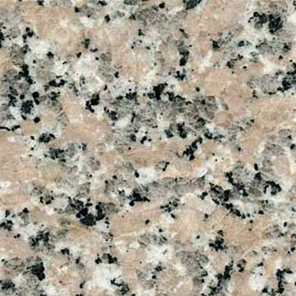
Characteristics of Granite:
Granite is made up of three minerals: quartz, feldspar and mica.
It is a hard, crystalline rock, which is very resistant to erosion.
It is an intrusive igneous rock.
The main processes that affect it are freeze-thaw and hydrolysis.

Slide 6
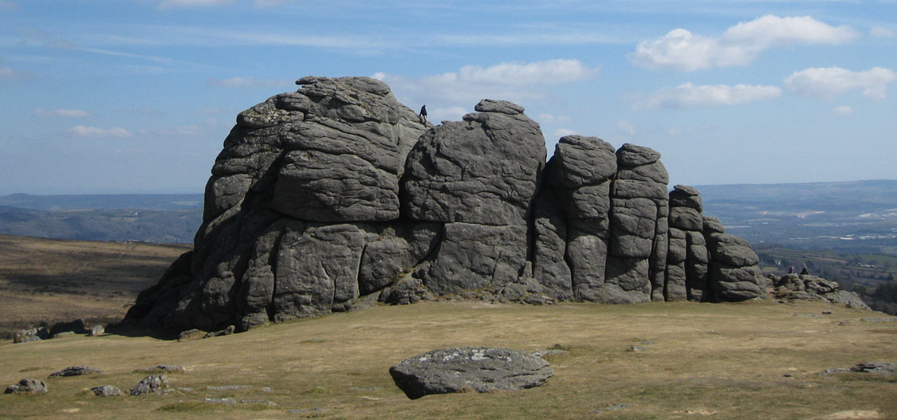
Task:
Annotate (add detailed labels) your photo to show key features of the Dartmoor Tors

Slide 7
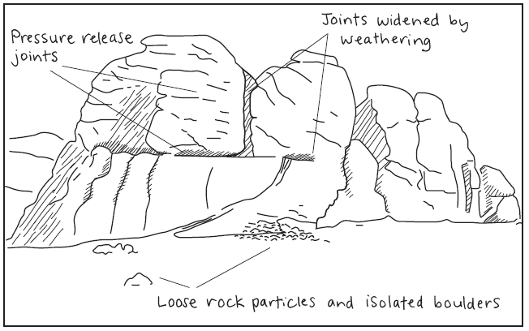
Field sketch of Hay Tor, Dartmoor UK

Slide 8
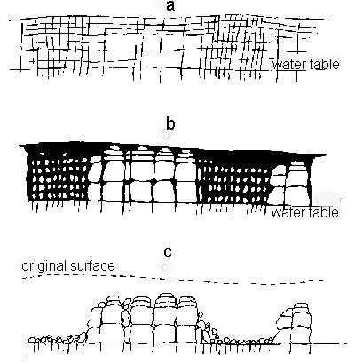

Slide 9
Tor Formation: Dartmoor
As this rock was removed there was a reduction of pressure on the granite as there was less above it. This caused it to crack creating joints.
Where the joints were close together weathering quickly broke down the rock. However there were also areas where there were very few joints and so slower weathering occurred.
This process continued over millions of years, leaving behind the tors and valleys seen on Dartmoor.

Slide 10
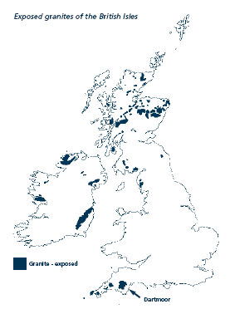
Overall – is the data even or uneven i.e. is it the same everywhere?
Pattern – where are the maximum/minimums, or different categories?
Place – give a located example for each pattern that you talk about
Anomalies – are there any odd ones out?
Data – give figures for the patterns, in the correct units.
The order to write your description is O PPD A.
Describe the distribution of Granite in the UK

