Slide 1
Why has global tourism increased?
Learning objectives
To know what the word tourism means
To understand how trends of world tourism have changed over time
To be able to give reasons to explain this growth in tourism

Slide 2
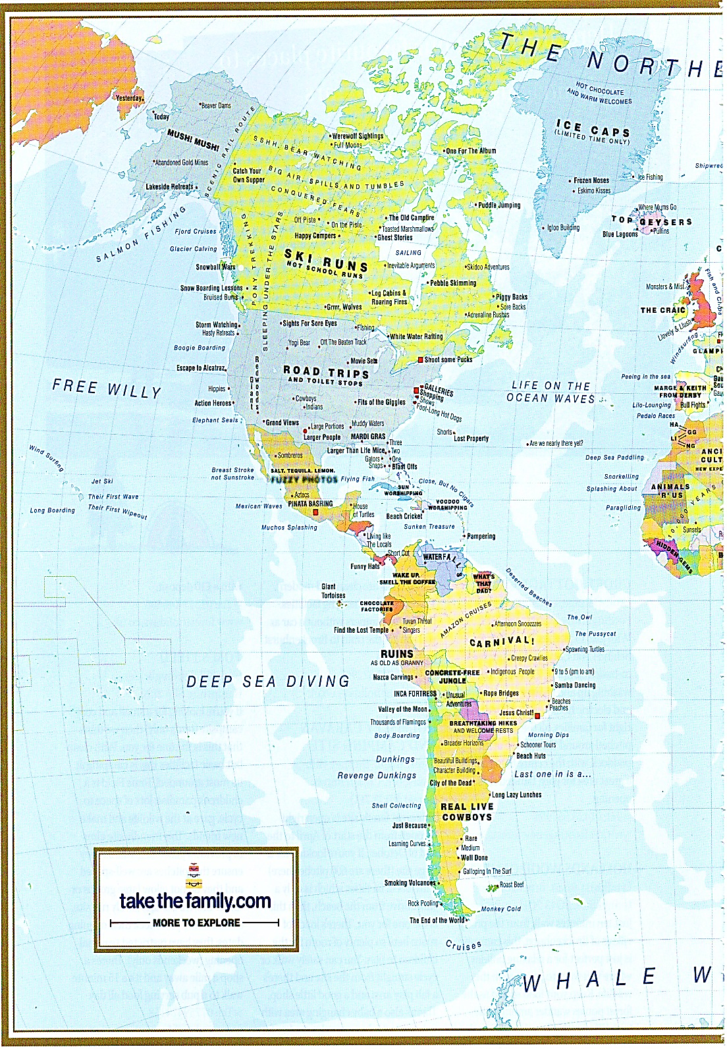
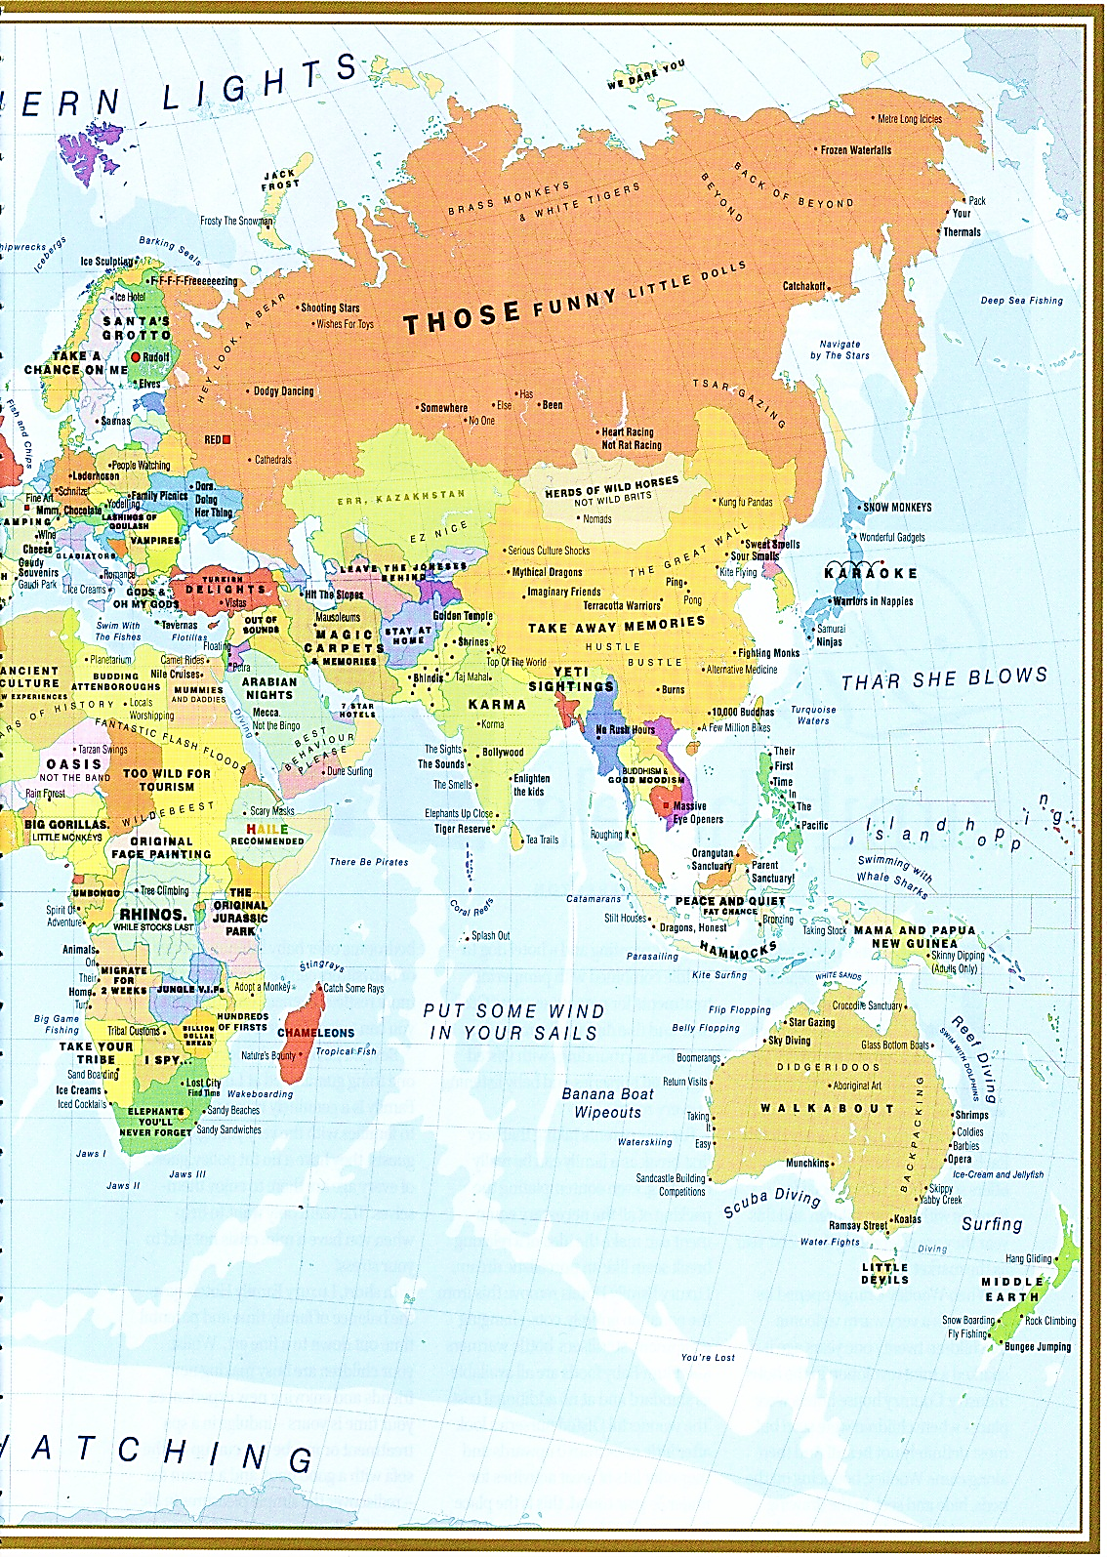
What do we mean by tourism?
Why has it increased?

Slide 3
KEY TERMS:
Tourism is travel for recreational, leisure or business purposes.
Tourists are people who “travel to and stay in places outside their usual environment for more than twenty-four (24) hours for leisure, recreation, holidays, to visit friends and relations and for business reasons.” (World Tourism Organisation)
International tourism: people going abroad for a holiday –In 2012 this exceeded 1 billion. This is predicted to increase to 1.8 billion in 2030.
Domestic tourism: people going on holiday in their own country- is between 4 and 5x greater than international tourism.
Tourism is the world’s largest and fastest growing industry, worth 9% of global GDP and one in eleven jobs. .

Slide 4
Types of tourism
Main Categories | Types
Leisure | Holiday, Sporting Event, Festival, Pilgrimage.
Visiting friends and relatives | Stay with friends, stay with relatives.
Business Visits and trips | Business meeting, Conference or exhibition, Educational trip, Medical treatment.

Slide 5
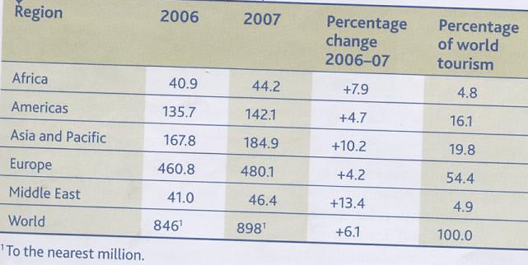
Table A p.295: International tourist arrivals (millions)
http://www.sporcle.com/games/GeordieGirl/top-tourism-destinations-worldwide-countries
Notes:
Can you name the countries that attract the most international tourists?

Slide 6
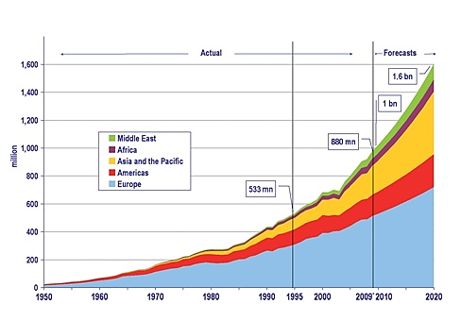
Compound line graph to show the number of tourists arriving in different regions (in millions)
Task: Describe the changes in global tourist numbers since 1950 (4 marks):
COPAD – Calculations, Overall, Pattern, Place, Anomalies and Data

Slide 7
Peer mark out of 4, with a star and a target
1 mark for saying it has increased over time
1 mark for referencing parts of the world (e.g. Europe is the biggest tourist destination)
1 mark for quoting statistics (e.g. 553 million tourists in 1995 worldwide)
1 mark for calculations e.g. tourism has increased from 25 million in 1950 to 1.6 billion in 2020

Slide 8
Trends in global tourism have changed over the past 50 years in terms of:
Numbers
Changes in global tourism
Activity
Origins
Organisation of holiday
Destinations
Why?

Slide 9
SUMMARISE (be concise but detailed) page 199 & The Geographer Online
Social Factors
Economic Factors
Factors causing the growth of tourism
Political Factors

Slide 10
SUMMARISE page 199
Increasing desire to experience different cultures and landscapes.
Currency exchange rates
Greater Wealth
Increase in leisure time (more paid holidays) and shorter working weeks.
Social Factors
Economic Factors
Increased media coverage of holidays has encouraged people to travel
Factors causing the growth of tourism
Developments in Transport e.g the growth in budget airlines means more people can travel further.
Travel restrictions have lifted, it is easier to get visas to travel to many more countries. E.g. China
Many governments have invested heavily in tourism
Political Factors

Slide 11
Recap… Exam question 6a) Explain why tourism has increased in the last 50 years.(3)
Mark scheme:

Slide 12
Tourist Attractions
Physical attractions: - or natural (primary) resources:
A stretch of scenic or spectacular coastline
An area of outstanding natural beauty – a specific range of hills/ mountains
A good climate for leisure and recreation
A lack of hostile physical elements, e.g. flooding, tsunamis…
Human attractions: - man made (secondary) resources:
The importance of a regions heritage + history
The provision of communications – airports, road, rail
The provision of necessary infrastructure – power, water, hospitals, hotels,
The impact of leisure facilities

Slide 13
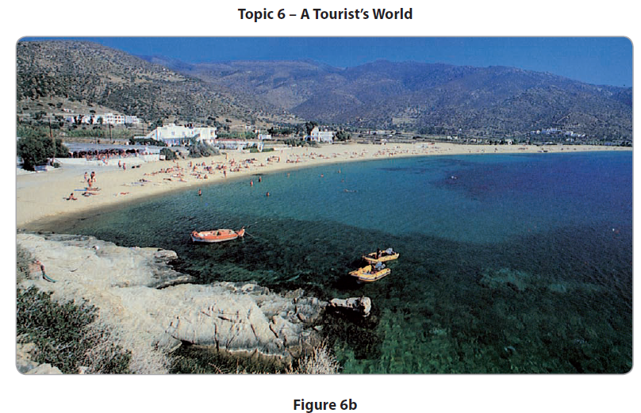
(b) Study Figure 6b It shows a holiday destination in the Mediterranean. ( (ii) Describe the physical and human attractions of the area shown in Figure 6b. (4)

Slide 14
Mark scheme for 6b)

Slide 15
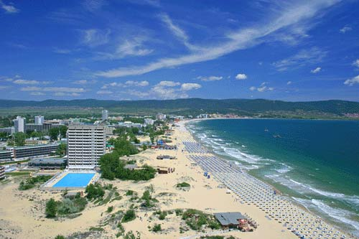
Notes:
beach

Slide 16
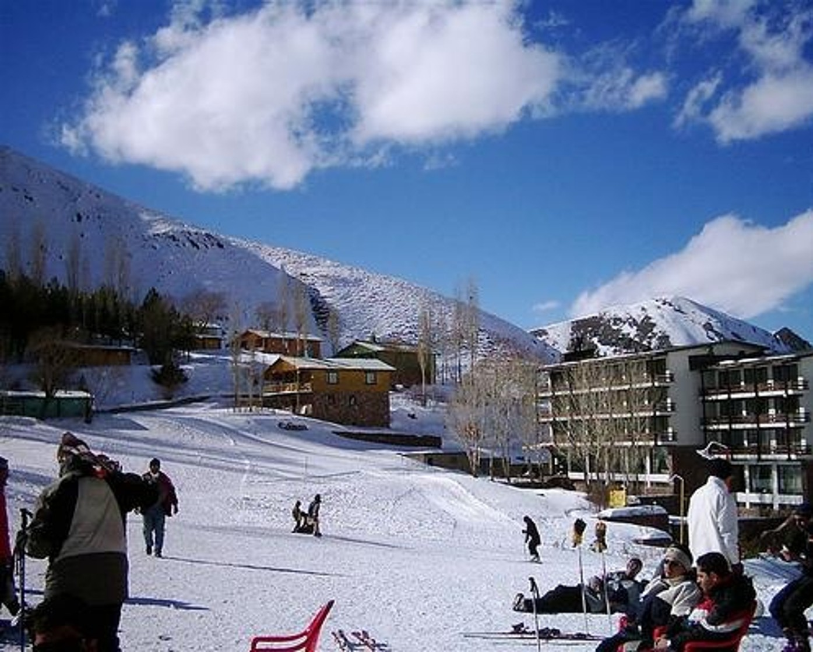
Notes:
Activity

Slide 17
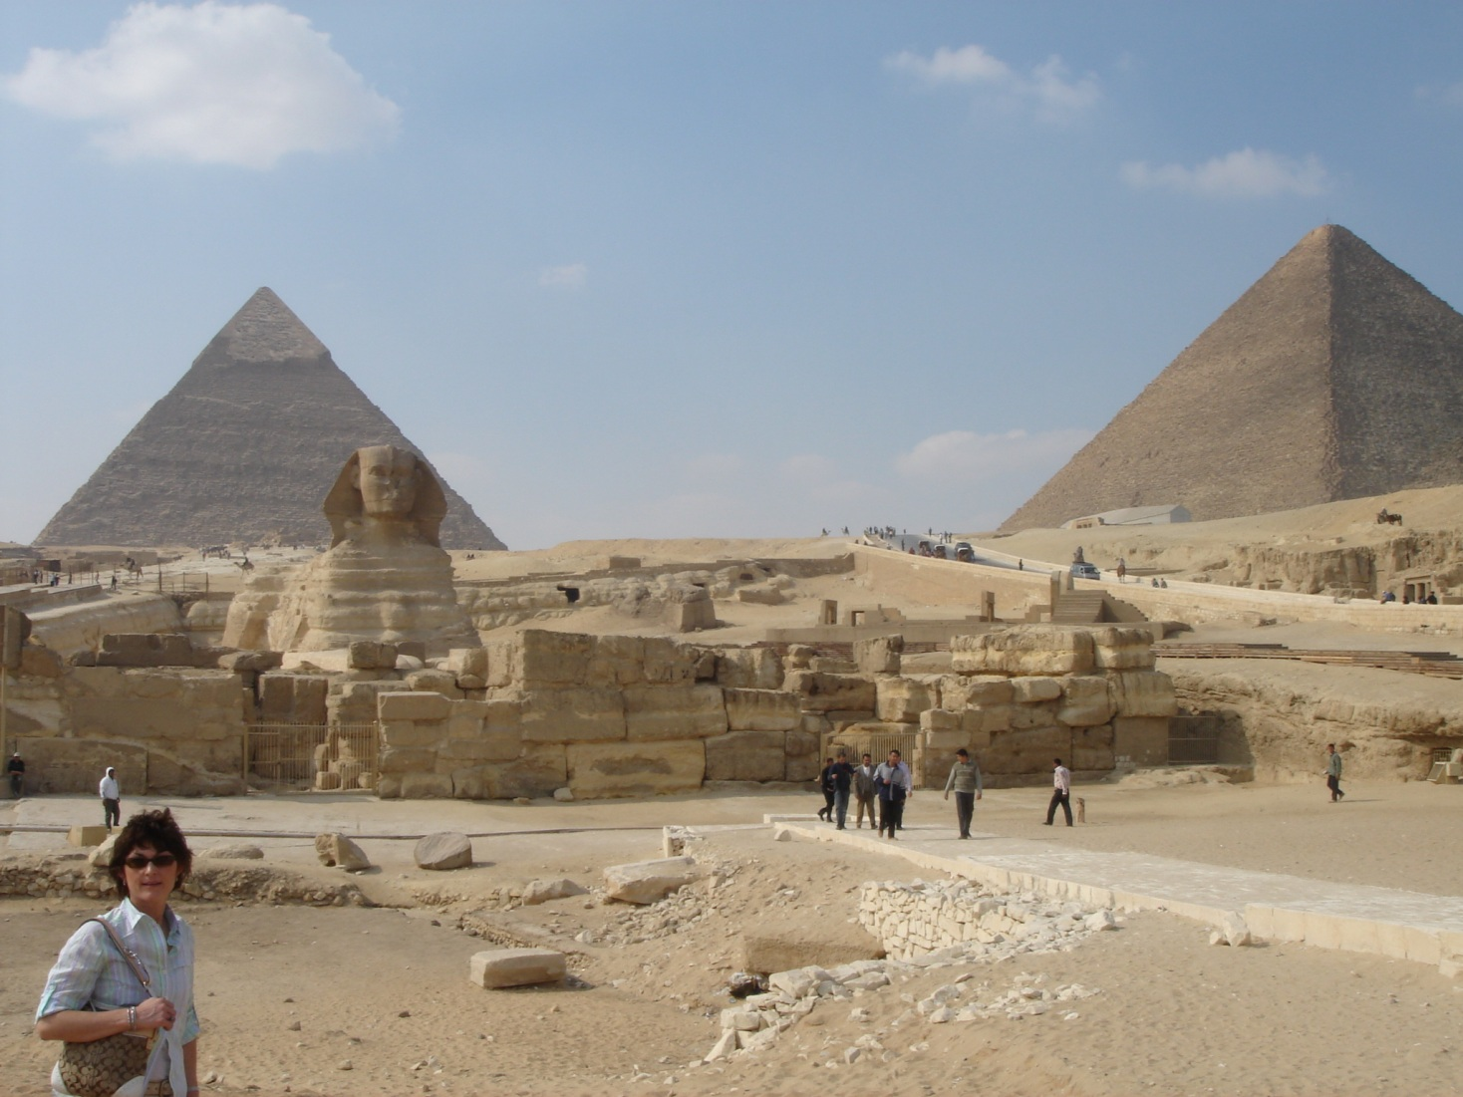
Notes:
Heritage

Slide 18
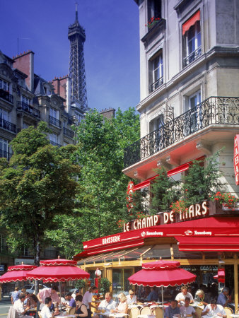
Notes:
Short city break

Slide 19
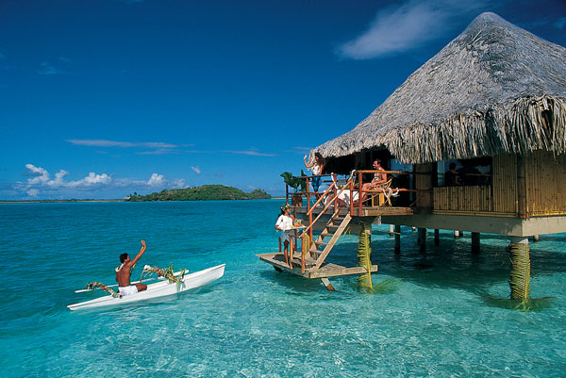
Notes:
beach

Slide 20
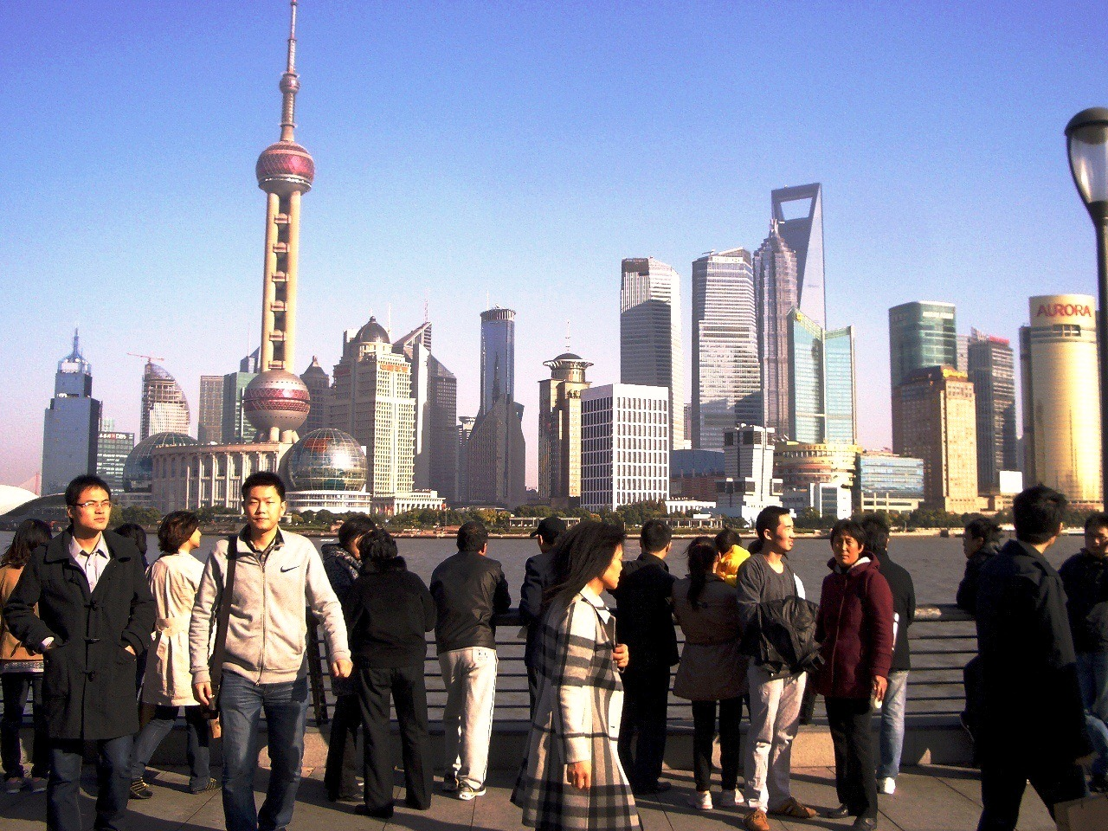
Notes:
Short city break - shanghai

Slide 21
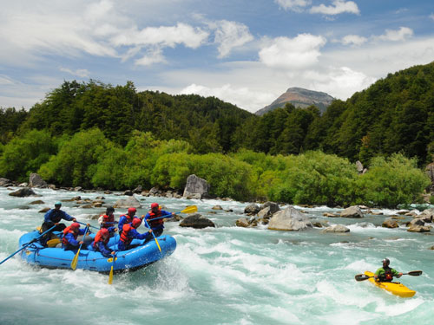
Notes:
activity

Slide 22
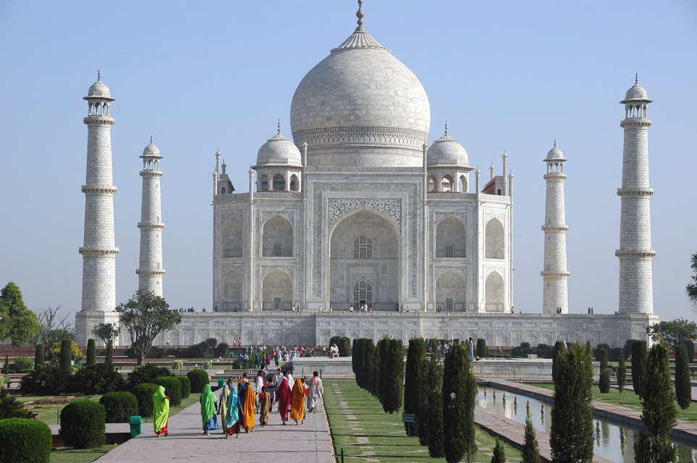
Notes:
Heritage/culture

Slide 23
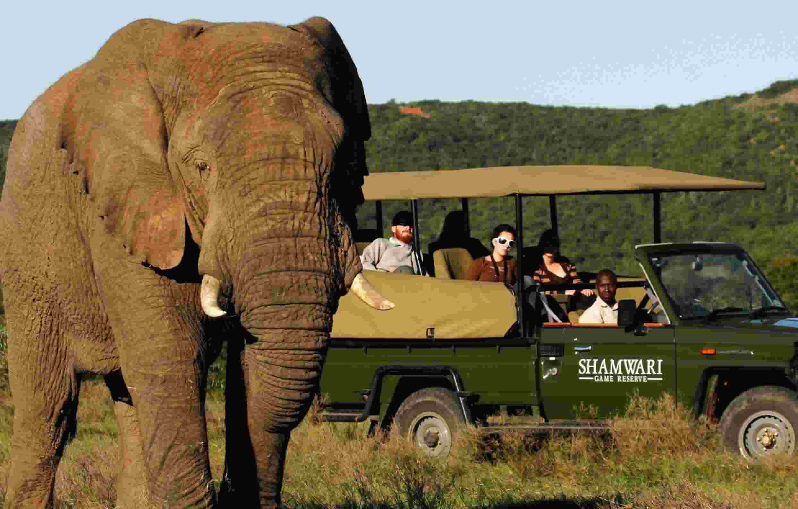
Notes:
Activity - safari

