Slide 1
MIGRATION

Slide 2
Definition
Migration – the temporary or permanent movement of people from one place to another

Slide 3
Reasons For Migration
?
?

Slide 4
Reasons For Migration
PULL FACTORS
PUSH FACTORS

Slide 5
Reasons For Migration
PULL FACTORS
PUSH FACTORS
Health Care
Climatic
Disasters
Peace
Education
Money
Farmers’
Life
Food
Jobs
City Life
War
Poverty

Slide 6
TYPES OF
MIGRATION
Consequences
Reasons
Internal
International
Rural-Urban
Voluntary
Seasonal
Involuntary
Planned

Slide 7
Internal Migration – Rural-Urban Migration
Movement of people away from the rural region (countryside, farms) to an urban (town, city) area.
Which age group is most prone to move?
Which group of country experiences large volumes of rural-urban migrants?
Why?

Slide 8
Internal Migration – Rural-Urban Migration
Which age group is most prone to move?

Slide 9
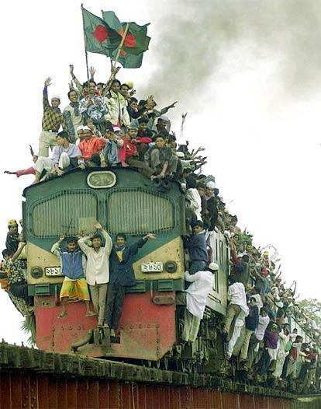
Able-bodied
MALE
Age 20s – 30s

Slide 10
Internal Migration – Rural-Urban Migration
Which age group is most prone to move?
Male
Age group – 20s and 30s
Able bodied – economically-active
Which group of country experiences large volumes of rural-urban migrants?
Developing countries, eg. India, Brazil

Slide 11
Internal Migration – Rural-Urban Migration
Main and most important reason for this movement – rural area cannot support the large and rapid population increase
Symptoms of rural overpopulation – reduced food supply, decreased job opportunities, shortage of land
Worsened by farm mechanisation. Why?
Machines replaced labour, jobs are lost, rising joblessness

Slide 12
Internal Migration – Rural-Urban Migration
IMPACT
Depopulation
Women take on greater share of farm work
Declining farm productivity
Social problems, single-parent family
RURAL AREA?
Widespread unemployment
Rise of squatter settlements
Overcrowding, unhygienic living conditions
Strain on urban facilities
Rising crime rates
URBAN AREA?

Slide 13
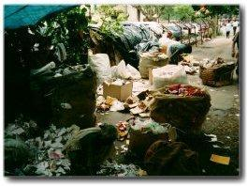
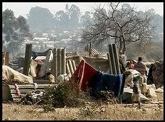
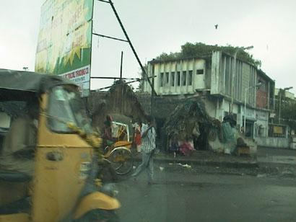
Internal Migration – Rural-Urban Migration
Squatter Settlements
In India

Slide 14
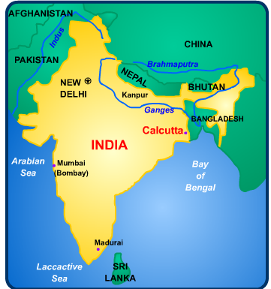
Title: Rural to Urban migration.
Source: Rural areas and small towns among Calcutta.
Destination: Calcutta’s Bustees (Shanty Towns).

Slide 15
Reasons:
Large population growth in rural areas puts more pressure on the environment.
Wages in Calcutta are approximately six times that of rural areas.
Sub-division of land passed on makes a subsistence life more difficult and reduces the assets against which a rural inhabitant could get a loan.
Increased mechanisation of agriculture to feed growing population means greater rural unemployment.
A large number of migrants are a consequence of natural disasters such as those faced annually in the Monsoon season. Many cross from nearby Bangladesh.
Indian cities receive approximately six times the investment of their rural counterparts.
Better medical and health care. Infant mortality is lower in Indian cities than rural areas.
Consequences for area they arrive in:
These are massive and one of the biggest problems facing all of the developing world. In Calcutta they include:
1. A chance to escape the rigid caste system that is still very strong in rural areas.
2. Higher rates of infant mortality than towns.
3. Half a million people sleeping on the streets.
4. Increased air pollution as the pressures of population create a need for more industry. In addition, people use wood and charcoal for cooking.
5. The old water system cannot cope. Leaking pipes allow contamination to enter the water supply. In Monsoon season, this is particularly bad as sewage infects the water.
6. Increased traffic causes greater air pollution problems. As many as 60% of the population suffer from breathing problems.
7. Bustees have to occupy the least desirable land. This is often prone to flooding particularly during monsoon season but also is likely to be located near industry increasing problems with air pollution but also experiencing toxic chemical discharge.
8. Alternatively the developments could be on steep slopes increasing the chances of landslides

Slide 16
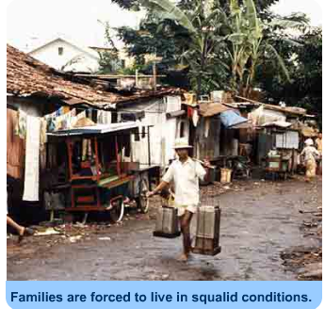
Consequences for area they leave:
1. If the migrant finds work in the city then it is likely that the village he left will benefit from money sent home. This is what every migrant dreams of but the situation in reality is usually very different.
2. As the pressures of urbanisation increase so government expenditure on urban areas must increase this leaves the rural areas facing an ever more difficult situation. Lack of investment on health and welfare will have obvious effects for those left behind.
3. It is the young motivated male that is most likely to leave. This has implications for those left behind. There will be a predominantly elderly population that will find it ever more difficult to support themselves.
4. Whilst migration may ease some of the population pressures the high birth rates in rural areas means the situation is deteriorating. This means a constant loss through migration with the break up of families.
Consequences for the migrant:
1. Forced to live in squalid conditions in the bustees
2. Often the only work available would be in the informal sector. Jobs here can include rummaging amongst rubbish tips to find materials that can be sold for re-cycling.
3. Often feel forced to stay in the cities not wanting to face the failure of going home.

Slide 17
Internal Migration – Seasonal Migration
Seasonal migration is also known as labour migration
It refers to the movement of people away from their homes to find a livelihood, usually on a temporary basis
Farmers moving their herds from the snow-covered uplands to lowland pastures
Apartheid System (African slavery system)

Slide 18
Internal Migration – Planned Migration
Planned migration refers to large-scale migration of people within the country
Usually carried out by the government
The most famous example – Transmigration Programme in Indonesia

Slide 19
Aims of the Transmigration Programme
Relieve population pressure in Java, Madura, Bali and Lombok
Increase job opportunities and raise standard of living in Java, Madura, Bali and Lombok
Increase production of food and tree crops

Slide 20
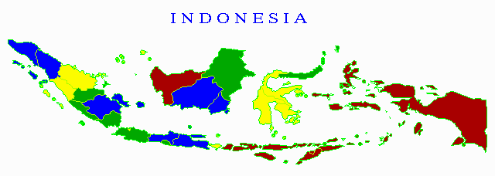
Los Angeles
London
Jakarta
New York
Bali
Ankara

Slide 21
Planned Migration (Transmigration)
Causes
uneven population distribution
plans to develop undeveloped areas
Effects
overcome landless problem & food shortage
raise std of living eg introduce cash cropping
cultural clash between migrants and locals
disrupt local way of life
widespread deforestation and soil erosion

Slide 22
POPULATION UNDER POVERTY LINE
41,8%
Population under poverty line :
< 5 % (Jakarta)
5 - 9 % (Bali, South Kalimantan, Banten)
10 - 14 % (West Sumatra, Riau, Jambi, Bangka Belitung, West Java, East Kalimantan
Central Kalimantan, North Sumatra, North Maluku)
15 - 19 % (North Sumatra, West Kalimantan, South Sulawesi)
20 - 24 % (South Sumatra, Bengkulu, Lampung, Central Java, Yogyakarta, West Java, Central Sulawesi,
North Sulawesi)
25 - 29 % (Aceh, NTB)
30 - 34 % (NTT, Gorontalo, Maluku)
Sources : CBS
> 35 % (Papua)

Slide 23
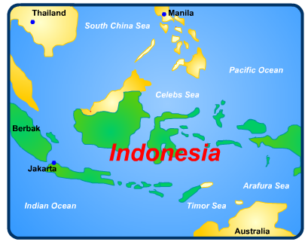
Title: Transmigration in Indonesia.
Source: Over populated islands of Indonesia, for example, Java.
Destination: Under populated outer Islands such as Maluku
Reasons:
Government incentives to ease population pressures on Islands such as Java.
Possibility of spreading development to more remote Islands.

Slide 24
Consequences for area they arrive in:
In total over three million people have moved so this obviously puts great pressures on the areas they arrive in. Thousand of acres of rainforest have been cleared and this has led to soil erosion. Consequently, a large quantity of the land soon becomes unsuitable for farming. This is made worse by the shortage of tool and destruction of crops by wild animals. The remoteness of Islands makes commercial farming very difficult.
There has been friction with the migrants and the indigenous population. Trans-migrants receive two hectares of land as an incentive to move. Indigenous people see this as government favouritism. The tension is accentuated as sometimes migrants are given areas of land that locals used for shifting cultivation.
In some of the least populated Island migrants threaten to completely out number locals.
Consequences for area they leave:
The population on main Islands like Java is continuing to grow rapidly and the trans-migration scheme is providing minimal relief. Also many trans-migrants are returning after having little success on the outer Islands. Transmigration has done little to remove the problems of over-population.
Consequences for the migrant:
Many migrants failed to make a living in the outer Islands finding life more difficult than that in Java. Indeed, average earnings were higher in rural Java than any re-settlement Island

Slide 25
International Migration – Involuntary Migration
Involuntary Migration = Forced Migration
Movement of people caused by events which force people to move against their will
People involved in this movement = Refugees
Refugees are persons who owing to well-founded fear of
persecution for reasons of race, religion, nationality or
political opinions, are outside of their country of origin and
cannot or owing to such fear, do not wish to avail themselves
of the protection of that country.

Slide 26
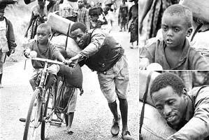
Refugees trying to move to move to safer places
with whatever belongings they have.

Slide 27
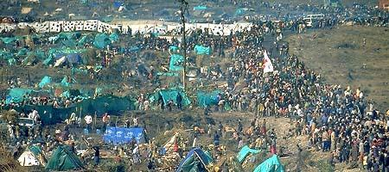
During the latter half of July 1994, nearly 1.5 million Rwandese fled to Zaire, giving rise to some of the largest refugee camps in the world. Kibumba camp, Goma region, Zaire.

Slide 28
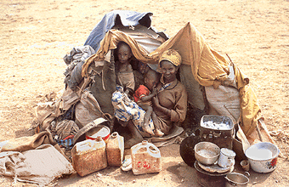
Living conditions in refugee camps are at best subsistence and nothing more. They can become permanent features.

Slide 29
Involuntary Migration
Causes
unfavourable social / political conditions
Examples
South Vietnamese fled communist Vietnam to Canada, USA, etc
Rwanda civil war in mid-1990s led to the fleeing of 2 million refugees
Migration of Hindus, Muslims and Sikhs to Britain in 1950s when Pakistan and India became separate countries

Slide 30
Involuntary Migration
Causes
unfavourable environmental conditions
eg droughts
Example
Ethiopians fled Sahel to go to surrounding areas

Slide 31
Involuntary Migration
Causes
unfavourable social conditions
eg persecution, civil wars
unfavourable environmental conditions
eg droughts, floods
Effects
refugees cause economic strain in host countries
poorly equipped refugee camps
unrest … refugees refuse to go home
racial conflicts in host country
Many refugees depend on aid from developed countries
Locked up in barricaded detention camps
Refugees who return face integration problems

Slide 32
International Migration – Voluntary Migration
Voluntary migration – movement of people by choice or one’s own free will
Reasons given for such movement is quite similar to reasons for rural-urban migration

Slide 33
International Migration – Voluntary Migration
Causes:
Lower living cost
More relaxed and less stressful lifestyle
Higher income and better lifestyle
Better recognition of their talents and skills

Slide 34
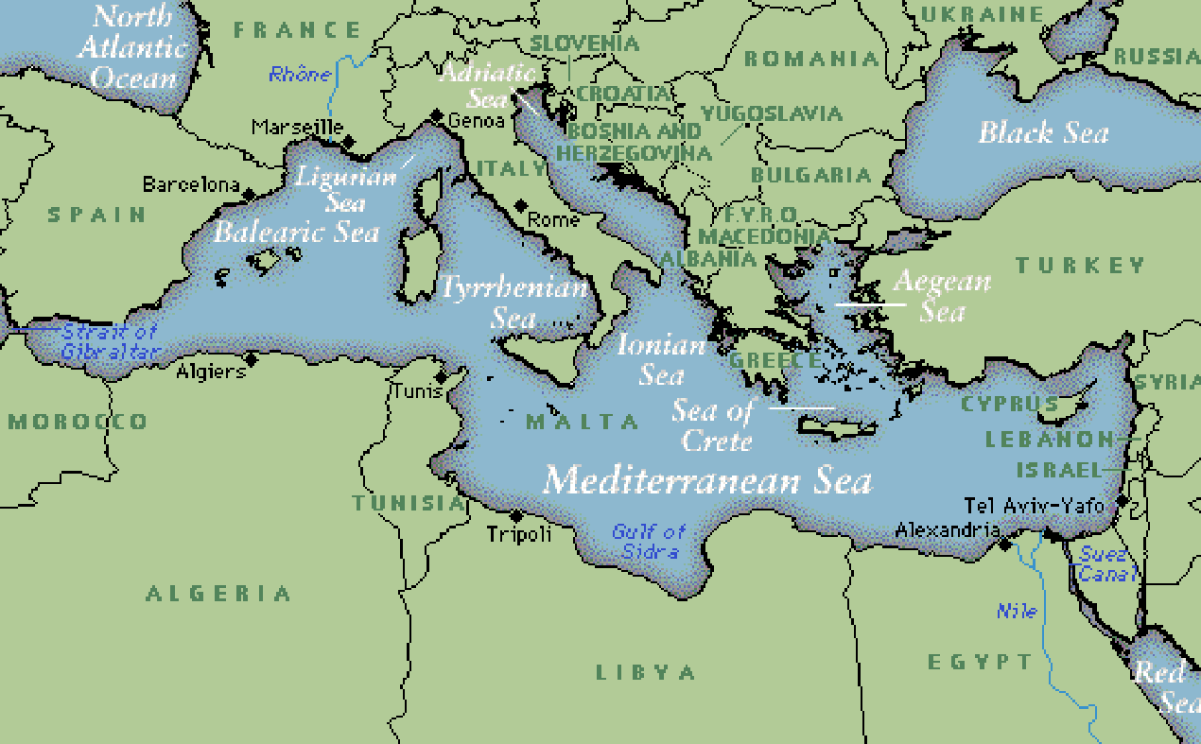
The Migrant Society in France

Slide 35
The Migrant Society in France
The population in France is about 60.6 million. Of these, 5 million consist of an immigrant population, the largest in Europe.
After World War 2, the rapid industrialisation of France created a demand for foreign workers. France needed factory workers and labourers and brought in Arab Muslims migrants to work in their industries. Along with these Arab Muslims migrants, France’s former colonies in North Africa and sub-Saharan Africa also contributed to the steady flow of the African migrants (mainly Algerians) into France.
These migrant workers then lived in government housing projects in the suburbs, or better known as ghettos. As time passed, the descendants of these migrants found that the jobs their fathers and grandfathers had done was no longer available to them. As a result, the unemployment rate among the immigrant society and their offspring increased. There is nearly 40% unemployment in the ghettos across France today. In addition, the second and third generation of immigrants have felt a lack of social mobility and reject their French identity.
- Weekend Today, 12-13 Nov 2005
Identify the causes and effects of the migration of foreign workers to France to work.

Slide 36
International Migration – Voluntary Migration
Impact:
Ethnic congregation, eg. Little Chinatowns and Little Indias in foreign land
Poor quality housing
Language difficulty
Racial tensions
Brain Drain

Slide 37
TYPES OF
MIGRATION
?
Internal
International
Legality
Rural-Urban
Voluntary
Legal
Seasonal
Involuntary
Illegal
Planned

Slide 38
Migration Difficulties
Lee tried to explain factors affecting migration in terms of the positive and negative characteristics of both the origin and destination.
Movements from an origin to a destination are likely to be influenced by obstacles at either origin or destination or enroute.

Slide 39
Migration Difficulties
physical barriers
immigration policies
Lack of capital
Travel costs
Illiteracy
Military service
Language
Family pressures

Slide 40
Migration is a common phenomenon.The world is shrinking. The world is becoming a global village.Country boundaries and barriers no longer restrict people movement.

