Slide 1
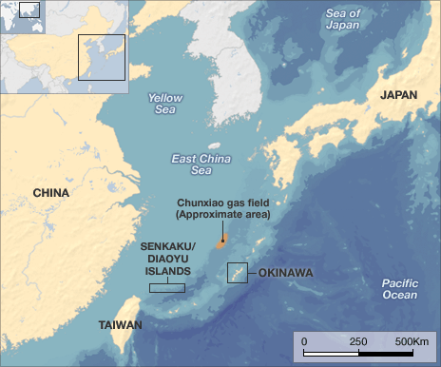
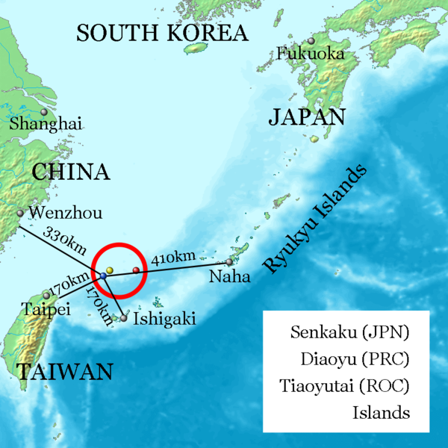
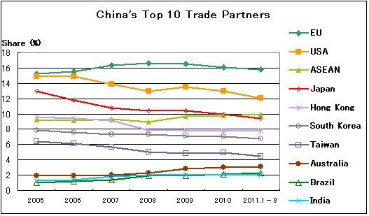
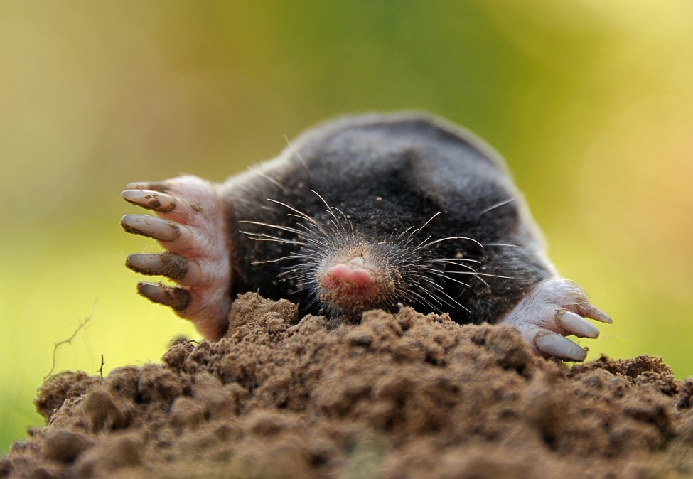
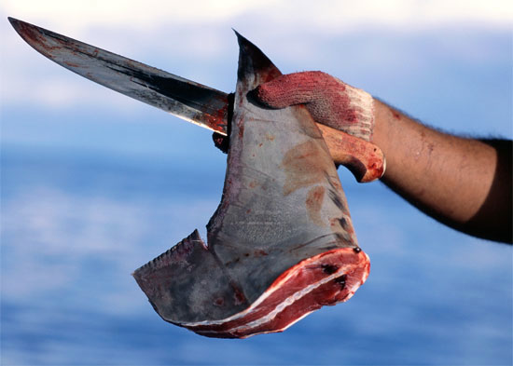
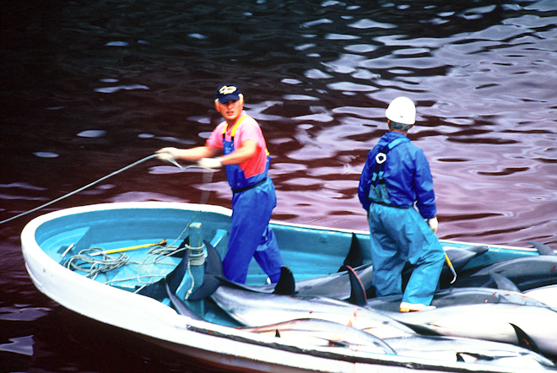
Conflict of Japan and China over the Senkaku Islands
WHY/WHERE
-Also known as Diaoyu Islands
-8 Uninhabited islands controlled by Japan in the East China Sea that add up to about 7 squared km
-The U.N Convention on the Law of the Sea gives countries the right to an exclusive economic zone extending 200 nautical miles from their coasts → many islands = many overlapping claims = conflict
-Discovered in 1968 that there was an estimated 1-2 trillion cubic feet of gas and 213 billion barrels of oil supplies under Ocean floor around the islands → conflict between China, Japan and Taiwan = whoever gets the islands gets the oil under the ocean floor around it
-Also good fishing grounds
WHOM
-China claims right to the islands because ruled over them in 14Th century → culture/ part of Chinese history → says Japan stole them 1895
-Japan claims the islands because at the end of the 2nd World War, Senkaku islands were given to USA through the United States Civil Administration of the Ryukyu Islands in 1945 and given back in 1972 under the Okinawa Reversion Agreement → say it’s theirs by law
-Taiwan claims the islands because it is closer to them than any other country so geographically is theirs + technically owned the islands since China only had a claim to them through Taiwan
CONSEQUENCES
-In 2008, China-Japan trade grew to $266.4 billion = raise of 12.5 percent on 2007 → making China-Japan the top two-way trading partners
-China was also the biggest destination for Japanese exports in 2009
-2010 = arrest of a Chinese captain after collision with Japanese boat = tension grew → China reduced export of rare mineral earth to Japan → deny arrest is the reason but Japan set aside 53.3 billion yen to reduce dependence on Chinese mineral resources
Chinese trade between 2005 and 2011
-2012 = Japan purchased 3 islands → trade deteriorated even more
-Japan/China would boycott each other/go to war if they could but both are to dependent on the trade between their countries to cut it off completely
WILDLIFE
-Also be consequences on wildlife → would probably exterminate the Senkaku Mole (=endangered) + disrupt the life of albatross and wild goats
-If Japan takes control of the islands → dolphins + whales will be slaughtered like in Taiji
-If China gets the islands → sharks + whales will be killed

